Slide 1
CUBES AND DICE

Slide 2

CUBES AND DICE
Cubes and Dice
Introduction
Concept of open and close dice
How to find numbers opposite number in dice
To find number or shape or figure on a face by comparing different figures
Concept of cube cutting
Finding number of cubes with 0, 1, 2 and 3 side coloured
Data Sufficiency

Slide 3

CUBES AND DICE
In both the diagrams, two faces numbered 1 & 3 are common.
Also, 5 & 6 are remaining faces. Hence, face which is number 5 is opposite to the face number 6.

Slide 4

CUBES AND DICE
In both the positions, face number 1 is common for both dice is same.
Therefore, the opposite of 4 is 2 and the opposite of 5 is 6

Slide 5

CUBES AND DICE
Here, faces with number 4, 3, 6 and 1 are adjacent to the face number 2.
Therefore, the 4,3,6,1 can’t be opposite to the face number 2.
Therefore, face number 5 is opposite to the face number 2.

Slide 6
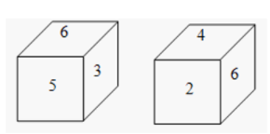
CUBES AND DICE
In the above dice, the face having value 6 is not in the similar position.
The face numbered 1 is not shown.
So, the face opposite to the face with number 6 is 1.
Also, the opposite face of 3 is the face with number 2 and the opposite to face numbered 5 is the face with number 1.

Slide 7
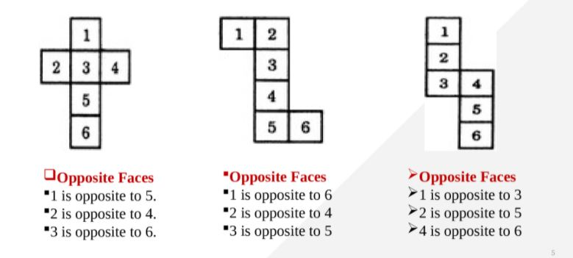
CUBES AND DICE
OPPOSITE FACES
1 is opposite to 5
2 is opposite to 4
3 is opposite to 6
OPPOSITE FACES
1 is opposite to 6
2 is opposite to 4
3 is opposite to 5
OPPOSITE FACES
1 is opposite to 3
2 is opposite to 5
4 is opposite to 6

Slide 8
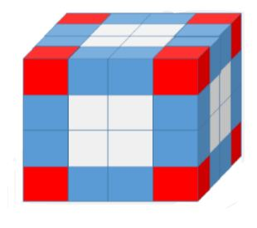
CUBES AND DICE
Shortcut Formulae
For a cube of side n*n*n painted on all sides which is uniformly cut into smaller cubes of dimension 1*1*1,
Number of cubes with 0 side painted= (n-2) ^3
Number of cubes with 1 sides painted =6(n -2) ^2
Number of cubes with 2 sides painted= 12(n-2)
Number of cubes with 3 sides painted=8(always)
For a cuboids of dimension a*b*c painted on all sides which is cut into smaller cubes of dimension 1*1*1,
Number of cubes with 0 side painted= (a-2)(b-2) (c-2)
Number of cubes with 1 sides painted =2[(a-2)(b-2) + (b-2)(c-2) + (a-2)(c-2)]
Number of cubes with 2 sides painted= 4(a+b+c-6)
Number of cubes with 3 sides painted= 8

Slide 9
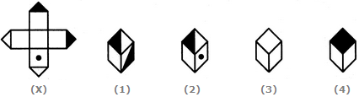
Q1. Choose the box that is similar to the box formed from the given sheet of paper (X). A.1 and 2 only B.2 and 4 only C.2 and 3 only D.1 and 4 only
CUBES AND DICE
Notes:
Option-C
Easy (Compulsory)

Slide 10
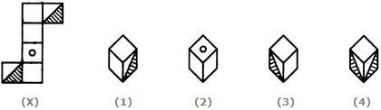
CUBES AND DICE Q2. Choose the box that is similar to the box formed from the given sheet of paper (X). A.1 and 3 only B.1 and 4 only C.2 and 4 only D.3 and 4 only
Notes:
Option-A
Easy (Compulsory)

Slide 11
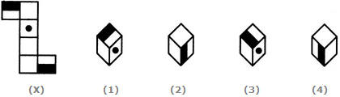
CUBES AND DICE Q3. Choose the box that is similar to the box formed from the given sheet of paper (X). A.1 and 2 only B.2 and 3 only C.2 and 4 only D.1, 2, 3 and 4
Notes:
Option-D
Easy (Optional)

Slide 12

CUBES AND DICE Q4. How many dots lie opposite to the face having four dots, when the given figure is folded to form a cube? A.2 B.4 C.5 D.6
Notes:
Option-C
Easy (Optional)

Slide 13
CUBES AND DICE
Q5. Four usual dice are thrown on the ground. The total of numbers on the top faces of these four dice is 13 as the top faces showed 4, 3, 1 and 5 respectively. What is the total of the faces touching the ground?
A.12
B.13
C.15
D.Can not be determined
Notes:
Option-C
Easy (Compulsory)

Slide 14

CUBES AND DICE Q6. If the total number of dots on opposite faces of a cubical block is always 7, find the figure which is correct A. Fig 1 B. Fig 2 C. Fig 3 D. Fig 4
Notes:
Option-B
Easy (Compulsory)

Slide 15

CUBES AND DICE Q7. Observe the dots on a dice (one to six dots) in the following figures. How many dots are contained on the face opposite to that containing four dots? A.2 B.3 C.6 D. Can not be determined
Notes:
Option-A
Easy (Compulsory)

Slide 16

CUBES AND DICE Q8. Three different positions of a dice are shown below. How many dots lie opposite 2 dots? A.1 B.3 C.5 D.6
Notes:
Option-C
Easy (Compulsory)

Slide 17

CUBES AND DICE Q9.The six faces of a dice have been marked with alphabets A, B, C, D, E and F respectively. This dice is rolled down three times. The three positions are shown as: Find the alphabet opposite A. A.C B.D C.E D.F
Notes:
Option-C
Easy (Compulsory)

Slide 18

CUBES AND DICE Q10.Three positions of a dice are given. Based on them find out which number is found opposite the number 2 in the given cube. A.6 B.5 C.3 D.1
Notes:
Option-A
Easy (Compulsory)

Slide 19

CUBES AND DICE Q11. A dice is thrown four times and its four different positions are shown below. Find the number on the face opposite the face showing 2. A.3 B.4 C.5 D.6
Notes:
Option-C
Easy (Optional)

Slide 20

CUBES AND DICE Q12. Two positions of a dice are shown. When 4 is at the bottom, what number will be on the top? A.1 B.2 C.5 D.6
Notes:
Option-A
Easy (Optional)

Slide 21

CUBES AND DICE Q13. Below are depicted the three different positions of a dice. Find the number of dots on the face opposite to the face with one dot. A.2 B.3 C.4 D.6
Notes:
Option-D
Easy (Optional)

Slide 22

CUBES AND DICE Q14. Two positions of a parallelepiped are shown below. When the number 3 will be on the top side, then which number will be at the bottom? A.1 B.4 C.5 D.6
Notes:
Option-C
Easy (Compulsory)

Slide 23

CUBES AND DICE Q15. Two positions of a block are given below. When 1 is at the top, which number will be at the bottom? A. 2 B. 3 C. 4 D. 6
Notes:
Option-D
Easy (Optional)

Slide 24

CUBES AND DICE Q16. Three different positions X, Y and Z of a dice are shown in the figures given below. Which number lies at the bottom face in position X? A. 2 B. 3 C. 6 D. Can not be determined
Notes:
Option-B
Easy (Optional)

Slide 25
CUBES AND DICE Q17. A bigger cube is painted yellow on each of its faces. Now the cube is cut into 2744 identical pieces making minimum number of cuts. how many of the smaller cubes will have exactly two faces painted? A. 144 B. 49 C. 58 D. 68
Notes:
Option-A
Moderate (Compulsory)

Slide 26
CUBES AND DICE Q18. A cube of each side 17 cm, has been painted black, red and green on pairs of opposite faces. It is then cut into small cubes of each side 1 cm. Find the No. of small cubes having no face painted ? A.3333 B.3375 C.3354 D.3575
Notes:
Option-B
Easy (Optional)

Slide 27
CUBES AND DICE
Q19. A solid cube of each side 12 cms, has been painted red, blue and black on pairs of opposite faces. It is then cut into cubical blocks of each side 3 cms.
How many cubes have two faces painted red and black and all other faces unpainted?
8
4
32
16
Notes:
Option A
Moderate (Compulsory)

Slide 28
CUBES AND DICE
Directions: A solid cube of each side 12 cms, has been painted red, blue and black on pairs of opposite faces. It is then cut into cubical blocks of each side 3 cms.
Q.20 How many cubes have two faces painted black?
None
8
2
4
Notes:
Option A
Moderate (Optional)

Slide 29
CUBES AND DICE
Directions: A solid cube of each side 12 cms, has been painted red, blue and black on pairs of opposite faces. It is then cut into cubical blocks of each side 3 cms.
Q21. How many cubes have one face painted blue and one face painted red? (the other faces may be painted or unpainted)
12
0
8
16
Notes:
Option D
Moderate (Compulsory)

Slide 30
CUBES AND DICE
Directions: A solid cube of each side 12 cms, has been painted red, blue and black on pairs of opposite faces. It is then cut into cubical blocks of each side 3 cms.
Q22. How many cubes have three faces painted with different colours?
8
4
0
12
Notes:
Option A
Moderate (Optional)

Slide 31
CUBES AND DICE
Q23. Find the side of larger cube?
Statements:
1) If we are having 125 smaller cubes.
2). If it was cut into smaller cubes of 1 cm each.
A.I alone is sufficient while II alone is not sufficient
B.II alone is sufficient while I alone is not sufficient
C.Either I or II is sufficient
D.Neither I nor II is sufficient
E.Both I and II are sufficient
Notes:
Option-E
Easy (Optional)

Slide 32
CUBES AND DICE
Q24. The no. of smaller cubes which are having zero-face painted.
Statements:
1). It is cut into smaller cubes of 1 cm each.
2). A cube having an edge of 19 cm each. It is painted red on two opposite faces, blue on one other pair of opposite faces, black on one more face and one face is left unpainted.
A.I alone is sufficient while II alone is not sufficient
B.II alone is sufficient while I alone is not sufficient
C.Either I or II is sufficient
D.Neither I nor II is sufficient
E.Both I and II are sufficient
Notes:
Option –E
Easy (Compulsory)

Slide 33
CUBES AND DICE
Q26. The six face of a cube are colored black, brown, green, red, white and blue, Which color is at the top?
Statements:
1) Green is opposite to blue
2).Green is at the bottom
A.I alone is sufficient while II alone is not sufficient
B.II alone is sufficient while I alone is not sufficient
C.Either I or II is sufficient
D.Neither I nor II is sufficient
E.Both I and II are sufficient
Notes:
Option-E
Easy (Optional)

Slide 34
CUBES AND DICE
Q27. The no. of smaller cubes which are having one-face painted.
Statements:
1) Bigger cube is cut into smaller cube of 2 cm side each
2). All the faces of the bigger cube are painted red
A.I alone is sufficient while II alone is not sufficient
B.II alone is sufficient while I alone is not sufficient
C.Either I or II is sufficient
D.Neither I nor II is sufficient
E.Both I and II are sufficient
Notes:
Option-D
Easy (Compulsory)

Slide 35
CUBES AND DICE
Q28. How many of the smaller cubes will have exactly one face painted?
Statements:
1) Having 3375 identical pieces making minimum number of cuts
2). Having 64 identical pieces making minimum number of cuts
A.I alone is sufficient while II alone is not sufficient
B.II alone is sufficient while I alone is not sufficient
C.Either I or II is sufficient
D.Neither I nor II is sufficient
E.Both I and II are sufficient
Notes:
Option-C
Easy (Optional)

Slide 36
Any Doubts???

